Slide 1
OOAD
Instructor: <Name>

Slide 2
Agenda
General Introduction
Class Modeling
Dynamic Modeling
Functional Modeling
Add Operations to the Class Model
OMT: Four phases

Slide 3
General Introduction
Object-Oriented Analysis
Class Model
  static structure
  what objects are in the system?
  how are they related?
Dynamic Model
  behavioral aspects
  what events occur in the system
  when do they occur and in what order?
Functional Model
  data transformations
  “what” does the system do
Data-Oriented
Action-Oriented
Both Data and Actions

Slide 4
General Introduction
OMT & UML (OMT turned into UML)
OMT [Object Modeling Technique - Rumbaugh et al.,1991] consists of
  building three complementary models of the system
  adding implementation details to the models
  implementing the models
OMT includes a set of
  phases [processes]
  diagramming techniques
OMT has four phases
  object-oriented analysis builds a real-world model
  system design determines overall architecture of system
  object design decides upon data structures and algorithms
  implementation translates design into programming language

Slide 5


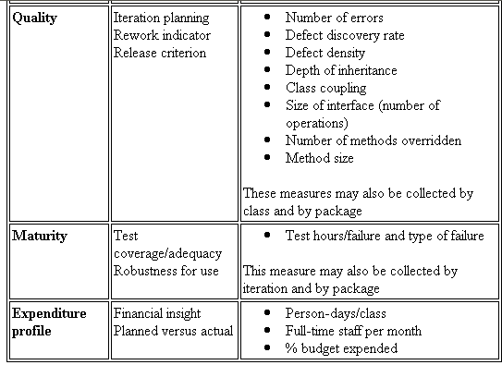


General Introduction
What is UML?
The Unified Modeling Language (UML) is a standard language for
Specifying
Visualizing
Constructing
Documenting
Business Modeling
Communications

Slide 6
General Introduction
OMT Stages & Models
Analysis
- Model of real-world situation
- What ?
System Design
- Overall architecture (sub-systems)
Object Design
- Refinement of Design
- Algorithms/data structures to
implement each class
Implementation
- Translation of object classes and
relationships to a particular
object-oriented language
Dynamic Model
- Control aspects of the system
(state diagrams)
Object Model
- Static structure of objects and their relationships
(object diagram)
Functional Model
- Data value transforamtions
(dataflow diagrams)
time
System

Slide 7
General Introduction
OO Analysis & Design Steps
Class Modeling
Dynamic Modeling
Functional Modeling
Add Operations to the Class Model
Iterate and refine the models
  After the first iteration, steps may occur in parallel
  or out of order
  All models must be kept in synch as changes are made

Slide 8
Class Modeling
Identify objects and classes
Prepare a data dictionary
Identify associations between objects
Identify class attributes and initial set of operations
Organize object classes using inheritance

Slide 9



Class Modeling
What is an object?
Represent an entity in the “real” world
Possesses operation (behavior) and attributes (data – state)
  Data ➔ contain information describe
  the state of objects
  Operation/Behavior ➔ Method inside class
  Consists of things that the object know how to do
Unique – Identifiable
Is a “black box” which receives messages
Notes:
Every object:
- Contains data: The data stores information that describes the state of the object.
- Has a set of defined behavior. This behavior consist of all the things that the object
"knows" how to do. These are the methods present inside the object.
- Has an individual identity. Each object is different from the other object even if they
are instantiated from the same class.
A primary rule of object-oriented programming is - as the user of an object, you would never need
to know what is there inside the object!

Slide 10

Class Modeling
Abstraction
Polygon
Attributes:
- vertices
- border color
- fill color
Operations:
- draw
- erase
- move
Abstract info

Slide 11
Class Modeling
Domain Analysis
Natural Language
Problem Domain
Nouns suggest candidate Classes.
Not every noun is an Object Class.
  Some are attributes of another Class.
  Some are irrelevant, outside the scope of the application.
Verb phrases suggest class associations
  Some relationships are irrelevant (caution).
Proper nouns suggest Objects of a Class type. Beware of singular nouns.

Slide 12

Class Modeling
Classes Identifying 1/2
Class is an abstract description of a set of objects
Class defines methods, variables for a kind of object
We actually write code for a class, not object
Use class as a blue-print to create (instantiate) an object
Polygon
Attributes:
- vertices
- border color
- fill color
Operations:
- draw
- erase
- move
instantiate
instantiate
instantiate
Notes:
Class như một bản thiết kế cho một loại object.
- Classifying objects
- Relating objects to one another
- Providing mechanism to define and manage objects.

Slide 13
Class Modeling
Classes Identifying 2/2
Finding classes:
  Use domain analysis as before.
  Derive them from the use cases (descriptions).
  Look for data which must be stored or analysed.
  Are there external systems?
  Are there any devices under the control of the system?
  Are there any organisational parts?

Slide 14
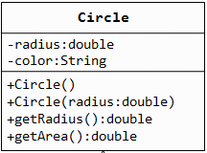
Class Modeling
Classes, Attributes & Operations
Attributes define the properties of the objects
  every instance of the class has the same attributes
  an attribute has a data type
  the values of the attributes may differ
  among instances
Operations define the behavior of the
objects
  action performed on or by an object
  available for all instances of the class
  need not be unique among classes
Class Attributes Operations
ball radius, weight catch, throw
football air pressure pass, kick, hand-off
baseball liveness hit, pitch, tag

Slide 15
Class Modeling
Attributes
Describe the state and characteristics of the object.
Must be typed, primitives like integer, real, Boolean, point, area, enumeration, these are primitives. May be language specific.
Visibility may be public, private or protected.
Class variables have scope across every instance of class, change one changes all (static attributes)
Syntax
  visibility name : type-expression = initial-value {property-string}
Only name and type are mandatory.

Slide 16
Class Modeling
Operations
Operations manipulate attributes and perform other tasks.
Scope is the Class.
Operation signature is composed of name, parameters and return type.
  name(parameter-list) return-type-expression
Scope and visibility rules apply.

Slide 17

Class Modeling
Encapsulation
Allow to show only the important methods as interface
Hide detail information
  Hide the data item
  Hide the implementation
  Access to data item only through member methods
Notes:
Capsule vs Tablet
Tablet : Thông tin/thành phần được exposed ra bên ngoài. Thuoc de bi tuong tac voi khong khi va nuoc. Khi uong co the co cam nhan ve mui vi cua thuoc
Capsule: Thành phần được gói kín bên trong. Thanh phan cua thuoc duoc bao ve tot hon. Khi uong, it kha nang cam nhan ve mui vi cua thuoc.
Encapsulation : Separate External Aspect from internal Implementation
Với encapsulation, OO can:
- hide the data item
- Chi co the access data item thông qua member method
Abstraction: Tell the external face we should present to the world
Encapsulation: Ensure implementation is not leak out
Abstraction & Encapsulation together reduce the amount of information we have to deal with.

Slide 18
Class Modeling
Access modifiers
Used for accessibility of data member and member methods
Example:
  Private
  Public
  Protected
  Friendly (Java)
Notes:
Private: data hoặc method được giấu, các object bên ngoài không thể access
Public: data hoặc method được public và có thể được accessed/modified bởi các object bên ngoài
Protected: data hoặc method có thể access/modified bởi các class thuộc cùng module/package
Friendly: data hoặc method có thể access/modified bởi các class được khai báo là friend của class đó.

Slide 19
Class Modeling
Information Hiding
Implemented by the “Private” access modifier
Hidden methods, member data can only be accessed by member methods
Benefit:
  Your brains doesn’t have to deal with it unless you’re specifically concerned with it
  When change occurs, the effects are localized

Slide 20
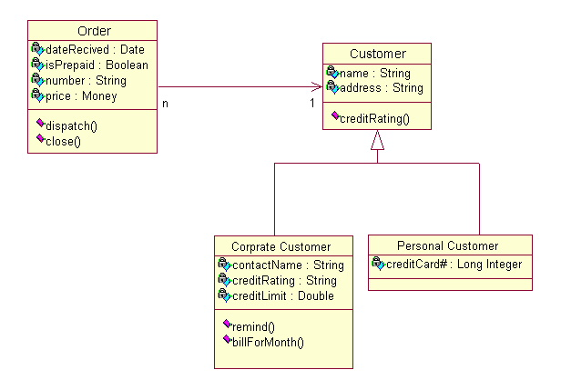
Class Modeling
Class Diagram
Class diagrams show the classes of the system, their interrelationships (including inheritance, aggregation, and association), and the operations and attributes of the classes.
Name
Inheritance
Associations
Aggregation
Relations
Attributes
Operations

Slide 21
Class Modeling
Associations & Cardinality
Association Name
Class1
Class2
Exactly One
(default)
Class
*
Class
Zero or more
0..1
Class
Optional (zero or one)
One or more
1.. *
Class
1..5,8
Numerically specified
Class

Slide 22
Dynamic Modeling
Prepare scenarios
Identify events between objects
Prepare an event trace for each scenario
Build a state diagram
Match events between objects to verify consistency

Slide 23
Dynamic Modeling
An example scenario
Scenario for a phone call
  caller lifts receiver
  dial tone begins
  caller dials digit (2)
  caller dials digit (7)
  caller dials digit (7)
  caller dials digit (6)
  specified phone rings
  etc.

Slide 24
Dynamic Modeling
OMT Event Trace Notation
objects are vertical lines
events are horizontal lines
arrows indicate sender and receiver
time passes from top to bottom
Customer Pump Credit Corp
“select method of payment”
select “credit”
insert card
slide card through reader
verify account
“select grade”
return “approved”
select “premium”
“pump on”
display unit cost, total cost, gallons dispensed
pump gas
update display with total cost, gallons dispensed
charge total cost to account

Slide 25
Dynamic Modeling
Event Trace Example
Caller
Phone line
Callee
caller lifts receiver
dial tone begins
dials (2)
dial tone ends
dials (7)
dials (7)
dials (6)
ringing tone
phone rings
answers phone
phones connected
phones connected
callee hangs up
connection broken
connection broken
caller hangs up

Slide 26
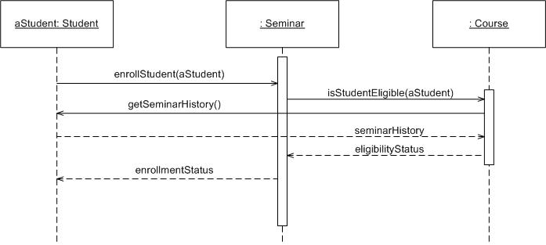
Dynamic Modeling
Event Trace ~ Sequence Diagram
Object: Class
A sequence diagram is
An interaction diagram that details how operations are carried out.
What messages are sent and when.
Sequence diagrams are organized according to time
Message
Operations
Lifeline

Slide 27
Functional Modeling
Hierarchical DFD
High-level functionality iteratively refined into smaller functional units
  each high-level process may be expanded into a separate DFD
  top-level processes correspond to operations on complex objects, while lower-level processes are operations on basic objects
Nesting depth is dependent on application
  terminates with simple functions
  each level must be coherent
Hierarchical DFD corresponds to the following
  context diagram shows boundaries of system
  mid-level DFDs show context decomposition
  primitive DFDs are simple functions that need not be expanded

Slide 28
Functional Modeling
DFD Example: Office Supply
Employee DB
AccountDB
verification
name/
password
account
number
verification
Web Server
input
stream
validate
employee
employee
validate
order
order
response (receipt)
Product DB
Order DB
verification
item
order
info
order
order
process
order
validated
order
finalize
order
response (receipt)

Slide 29
Add Operations to the Object Model
From the Object Model:
  Reading/writing object attributes (e.g., get_width, get_height of Rectangle)
From Events, State Actions, and Activities
in the Dynamic Model:
  Each event sent to an object => operation
  (e.g., Vending machine: set_balance)
  Actions/activities may be operations
  (e.g., Vending machine: do: test item and compute change)
From Functions in the Functional Model:
  Each function in the DFD corresponds to an operation (e.g., bank example: subtract withdrawal from Account)

Slide 30
OMT: Four Phases
System design
  determines overall architecture of system
Object design
  Definition all the classes in the system
Detailed Design
  decides upon data structures and algorithms
Implementation
  translates design into programming language

Slide 31
OMT: Four phases
1. System Design
Devises high-level strategy for solving problem
  Set trade-off priorities
Construct system architecture by organizing into subsystems (system structuring)
  Choose an approach for persistent data management (repository model)
  Allocate components to processors and tasks (distribution model)
Choose the implementation of control in software system (control modeling)
  Identify concurrency inherent in the problem
  Define access to global resources
Divide problem into implementable components (modular decomposition)

Slide 32
OMT: Four phases
2. Object Design
Full definition of all the classes in the system
Implementation alternatives evaluated and chosen
Combine three models to obtain class operations
Design algorithms to implement operations
Optimize access paths to data
Implement control for external interactions
Adjust class structure to increase inheritance
Design associations
Determine object representation
Package classes and associations into implementable modules

Slide 33
OMT: Four phases
3. Detailed Design 1/2
Detailed design is the process of completely specifying an architectural design such that module implementation can proceed (independently)
Interface specifications
  brief description of each module
  attributes
    brief description and specify types
  operations
    brief description
    list of parameters and parameter types
    return type (if applicable)

Slide 34
OMT: Four phases
3. Detailed Design 2/2
Algorithm and data structure specification
  the designer can give hints as to what algorithms or data structures might be most useful for a particular module
  also, the client may have specified a particular algorithm or data structure that must be used
  in addition, constraints in the requirements may require one approach over another
    for instance, implementing a data structure so that it uses the minimum amount of memory possible vs. keeping everything in memory for speed

Slide 35
OMT: Four phases
4. Implementation 1/2
Most programming languages provide very similar sets of features
  user-defined types
  control structures
    if...then...else...
    while x do y
    for i = 1 to x
    etc
  etc.
This means that, in general, operations can be expressed in many different languages

Slide 36
OMT: Four phases
4. Implementation 2/2
Major differences between languages usually fall into these categories
  compiled vs. interpreted
  procedural vs. object-oriented
  general purpose vs. application/domain specific
    e.g. C++ vs. FileMaker Pro’s scripting language
If a design takes advantage of, or depends on, one or more of these features then certain programming languages have to be excluded from implementation

Slide 37
Q & A

